Slide 1
Business for Peace “B4P”
Enabling a transformative role for business in peace

Slide 2
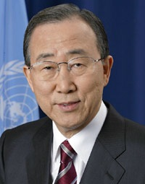
Business for Peace: Overview
Aims to expand and deepen private sector action in support of peace
Locally driven
Centred around the Guidance on Responsible Business in Conflict-Affected and High-Risk Areas: A Resource for Companies and Investors
17 Local Networks and 80+ Companies joined by signing the Statement of Support
Notes:
Launched by UN Secretary-General Ban Ki-moon in September 2013, B4P was created with the LNs: Building on over a decade of engagement with companies and experts and on the development of new and stronger LNs, the GCO conducted a consultation process, involving interested LNs and engaged companies and other stakeholders; to create B4P.
17 GCLNs and over 80 companies have already joined the initiative.
Business for Peace (B4P) is a business leadership platform dedicated to expand, advance and deepen private sector action in support of peace - in the workplace, marketplace and local communities.
Assists companies in implementing responsible business practices aligned with the UN Global Compact Ten Principles in conflict-affected and high-risk areas and catalyze action to advance peace.
Business for Peace is designed to stimulate business engagement and action as articulated in the Guidance on Responsible Business in Conflict-Affected and High-Risk Areas: A Resource for Companies and Investors (the Guidance) which will guide the platform’s approach and activities.

Slide 3
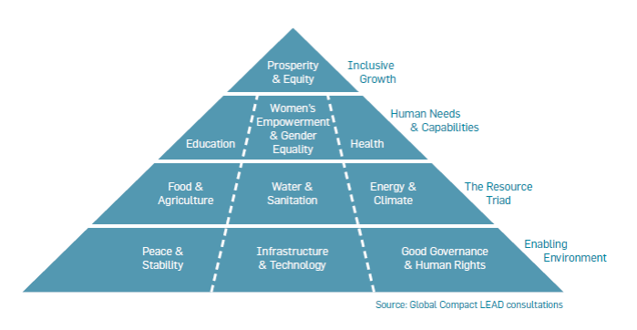
Post-2015 Business Engagement Architecture
Notes:
Peace & security is important for societies and business. Identified as one of the core elements of an environment that enables long-term sustainable development, as we see here in the Post-2015
Growth of the Global Compact shows increasing engagement on the part of companies…
Investors: Business working with investment markets in new ways – “responsible investors” who have also embraced sustainability.

Slide 4
Business for Peace: Objectives
To mobilize business engagement in support of peace.
1. Enhance understanding of business contributions to peace
2. Catalyze and facilitate corporate action and partnerships that contribute to peace
3. Facilitate business participation in multi-stakeholder dialogue for peace
4. Foster transparency and accountability
Notes:
With a view to mobilizing a movement of business engagement in support of peace, not only at the global level, but locally, in support of peace, the B4P will pursue the following objectives:
1. Enhance understanding of business contributions to peace: what are the positive impacts that businesses actually has on peace, how can that be measured (indicators)? Companies want to know exactly what their contribution is.
2. Catalyze and facilitate corporate action and partnerships that contribute to peace;
3. Facilitate business participation in multi-stakeholder and policy dialogue for peace: on issues identified as critical in a specific context (local) and to feed into the broad peacebuilding debate at the UN;
4. Foster transparency and accountability: to inspire by sharing practices, to stimulate peers review and to build empirical learning understanding on what works and what doesn’t in order to be able to replicate and scale practices that have a positive effect;
End goals:
Our intent is to bolster a global movement of business engagement for peace.
It is important to highlight than a growing number companies have a clear understanding of their role in relation to peace and of the importance to conduct responsible business practices that take into account the context and specific issue. Many have formulated new operating procedures tailored towards “doing no harm” – to sustain their activities by gaining a social license, but some are also seeking to go beyond this approach and create shared value with local communities.
Acknowledging that a number of issues can only be addressed through a collective efforts, some companies are ready and willing to engage to help government and civil society address policy issues at the global and local level.
- More and more companies working in high-risk environments signal that they need to support at the local level: expertise, knowledge and understanding of the context, connection with key development and peacebuilding actors. So B4P builds on the Local Networks, 100 countries, 17 engaged in B4P.

Slide 5
Global-Level Support & Engagement Model
Global-Level Support
Awareness Raising
Capacity Building
Experience Sharing
“Learning Journey”
Visibility
Incentivize Engagements
Guiding Principles and Resources
Best Practices
Enable Transparency
PS engagement in global policy dialogue
Report
Commit
Act
Notes:
Business for Peace is structured around two main pillars: (i) the instrumental role of local stakeholders;
And (ii) the “Commit, Act, Report” model, which guides the efforts of all Business for Peace participants at both local and global level.
Local ownership is key: due to specificity of each context, knowledge and contacts of local actors
GCLNs are playing a driving role:
Embed the principles in corporate culture
Facilitate action and partnership project
Identify specific thematic priority issues where learning and engagement needed.
Build bridges between SH and governments, to identify key national policy issues where PS engagement is needed, facilitate dialogue.
***B4P is the first Global Compact platform that GC Local Networks can also join through a public commitment, alongside the individual companies themselves.
The role of GCO is to support companies (and LNs) to advance their commitments to B4P.
This is done through a supporting, coordinating and bridge building role, and provide various engagement opportunities, based on national priorities:
- support efforts of GCLNs and providing support/capacity building EX: to mainstream principles and partnerships,
- sharing experience gathered at the local level and feeding into the learning journey,
- supporting the UN in engaging with the PS in policy discussions on peacebuilding and statebuilding.
EX: Work with the PBC to convene a dialogue on PS contribution to PB and plan to build on it at the local level.
- Provide visibility to companies making substantive contribution to peace to incentivize others to engage (EX: Oslo Business for Peace Award).
- Guiding principles and resources
- facilitate reporting and sharing of best practices
(Which brings us to the second pillar, the “Commit, Act, Report”-model)
“Commit”: Companies, business associations and GC Local Networks commit to B4P by signing the Statement of Support. This document outlines the terms of engagement and objectives of the initiative and declaring publicly their intention to make a contribution to advance peace.
“Act”: Business for Peace participants are expected to take action at two levels:
(1) integrating their policies and practices to the GC principles; and
(2) engaging in projects that are expected to make a contribution to peace (partnerships on peace-related issues, such as job creation, contribution to post-conflict reconstruction effort, etc.).
“Report”: Business for Peace participants are required to report on the actions taken and progress on an annual basis through their COP. The reporting requirement will build a database of information that will serve to identify best and emerging practices, share them with peers, feed into the learning process and demonstrate leadership.

Slide 6
The Role of Local Networks
Local Networks work to support companies through the following ways:
Pillars of Engagement
1. Support companies in implementing the Ten Principles when operating in high-risk and conflict-affected areas.
2. Engage in multistakeholder learning and dialogue to advance peace in the workplace, marketplace, and in local communities.
3. Where possible, help identify priority areas to facilitate and broker partnerships to enhance corporate engagement.
Types of Action
Public-Private Dialogues
1. Organizing awareness-raising, campaigns, and outreach events.
2. Customizing existing tools and resources to local context.
3. Supporting implementation and disclosure with an emphasis on high-risk or conflict-affected areas.
4. Supporting projects and collective action contributing to peace with or across sectors and social issue areas.
5. Convening multi-stakeholder dialogues.
6. Creating regional, national, or local level recognition or awards schemes.
7. Assisting other Local Networks in high-risk or conflict-affected areas.
7
Notes:
Global Compact Local Networks are uniquely positioned to support companies, business associations, and other stakeholders in achieving the objectives of the Global Compact. They maintain essential roles in mobilizing global issues within particular geographic contexts, and can enable companies with operations in high-risk and conflict-affected areas to contribute to the most fundamental of UN goals: peace.

Slide 7
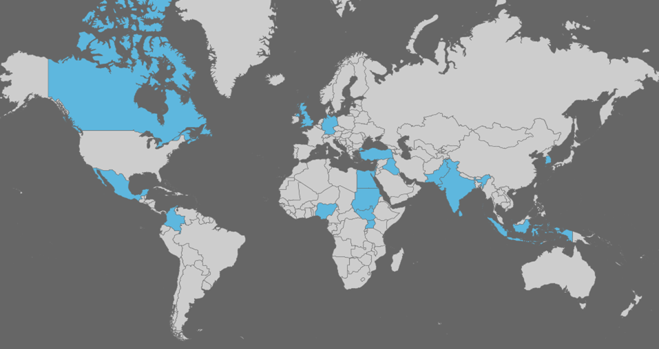
Business for Peace: Countries of Focus
Currently, 17 UN Global Compact Local Networks and 1 Regional Centre have joined B4P:
Canada, Colombia, Egypt, Germany, India, Indonesia, Iraq, Israel, Korea (Republic of), Mexico, Nigeria, Pakistan, Sri Lanka, Sudan, Turkey, Uganda, United Kingdom, and the Regional Center for the Support of the Global Compact in Latin America and the Caribbean
Notes:
7

Slide 8
How Companies Engage
Companies (senior-level executives) and Global Compact Local Networks can join B4P by signing the Statement of Support. Companies agree to take action by:
Pillars of Engagement
1. Paying heightened attention to implementing the UN Global Compact 10 principles in high-risk/conflict-affected areas
2. Take action and engage in partnerships to advance peace and development
3. Annually communicate on progress (in their COP) to make their actions for peace public
Public-Private Dialogues
7
Notes:
Companies (senior-level executives) and Global Compact Local Networks can join B4P by signing the Statement of Support.
Companies agree to take action by:
1. Implement the GC principles in all areas where the company operates – with a focus on high-risk/conflict-affected areas
The first pillar will focus on corporate investment and strategic decisions underlying their operations or planned operations in difficult operating environments around the world as outlined in the Guidance for Responsible Business and Investment in High-Risk Areas.
2. Take action to advance peace
The second pillar will focus on supporting action and partnership projects that businesses can undertake to make practical contributions to peace and development at the local-level. A suggested menu of actions and initiatives will be developed (in collaboration with GC Local Networks) and companies can customize their activities in areas which are likely to have the highest potential for positive impact on human security in a specific area. Companies will engage in learning and dialogue to advance progress and participate in an annual B4P meeting to share experiences.
Concepts of both “respect” and “support” in “conflict-sensitive business practices”:
- Extra efforts are required to fully implement policies and practices consistent with the Global Compact in high-risk areas.
- Potential for the private sector to play a positive role in promoting peace and development in post-conflict settings.

Slide 9
Why Companies Participate
Better identify and manage business risks and opportunities while reducing operational costs;
Engage in public-private dialogue to establish local priorities and implement projects;
Align business strategies and operations with good practice from across the globe;
Share best and emerging practices and learn from the experiences of peers; and
Demonstrate leadership and receive recognition for advancing practical solutions.

Slide 10
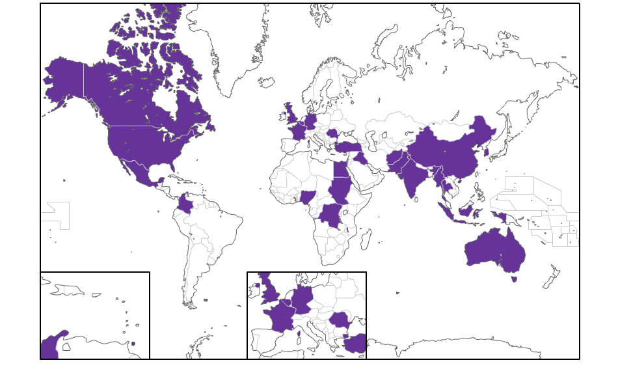
Business for Peace
– Company & Business Association participants
85+ companies and business associations in 26 Countries
This includes FT 500 companies as well as small and medium sized enterprises from over 20 different sectors
B4P company participants include:
Alvimedica (Turkey)
ANDESCO (Colombia)
Barrick Gold Corporation (Canada)
Brandix Lanka (Sri Lanka)
Equal International Pay Ltd. (Australia)
The CSR Agency (Romania)
E-Prospects (UK)
Fauji Fertilizer Company Ltd (Pakistan)
Khalid Emran Ltd (Afghanistan)
Holcim (Switzerland)
Mansour Group (Egypt)
Mynamar Polestar Travel & Tours (Myanmar)
PT Martina Berto, Tbk (Indonesia)
Sinopec (China)
Sudatel (Sudan)
Telefonica – Colombia (Colombia)
Toks (Mexico)
Unilever (Anglo-Dutch)
Notes:
10
Here we see how companies and business associations are already joining the initiative. (as of March 2014)
We already have over 85 private sector actors who have signed on, in 26 different countries. From telecom in Sudan to retail & food in Mexico, companies are committing to not only take action to advance peace, but report annually on their actions.

Slide 11
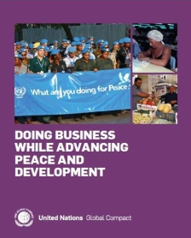
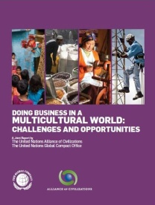
B4P Resources
Responsible Business Advancing Peace
Examples of how companies, investors and Global Compact Local Networks have used the "Guidance on Responsible Business in Conflict-Affected and High-Risk Areas” to align their policies, engage with investee companies and advance implementation of responsible business practices.
Guidance on Responsible Business in Conflict-Affected & High-Risk Areas: A Resource for Companies & Investors
Designed to stimulate learning and dialogue and to promote collective action and partnerships. It provides guidance on what constitutes “responsible” business practices in high-risk/conflict-affected areas. Developed by an expert group comprised of company representatives, investors, civil society leaders, UN representatives and others.
Doing Business While Advancing Development and Peace
Provides illustrative examples of how companies from a variety of sectors are positively contributing to peace and development in conflict-prone or post-conflict operating environments.
Doing Business in a Multi-Cultural World: Challenges and Opportunities
This publication helps companies to address cross-cultural issues and explore how they can facilitate intercultural understanding in ways that benefit both business and society.
11
Notes:
UN Global Compact with a long record of engaging companies in this area have created an array of practical resources to enhance the capacity of its participants.
- Governments assume primary role for peace, but companies have a key role to play in high-risk areas.
Peace and stability are essential for sustainable economic growth: expanding investment opportunities, reducing operating costs, and lending predictability.

Slide 12
Thank you
b4p@unglobalcompact.org

